Slide 1
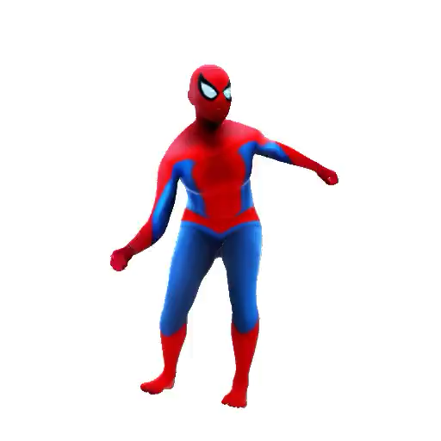
Spiderman is
jump kicking

